Slide 1

Designing Cloud Application
BY Geetika Koneru

Slide 2
Table of Contents
Business Objective
High level architecture
Public cloud and Private cloud business proposals
Implementation flow
MapReduce and Spark cluster support
Setup and Deployment
Hardware and Software configurations
Cost comparison and analysis
Conclusion and recommendation

Slide 3
Business Objective
To provide an online reservation management system with concentration on providing customer recommendations and alerts.
Internal functionalities include design for outgoing alerts, payment interface, geolocation tracking, analytics and data backup.
Application quotes demonstrated on public and private cloud platforms using AWS( Amazon Web Services) and Open stack.

Slide 4
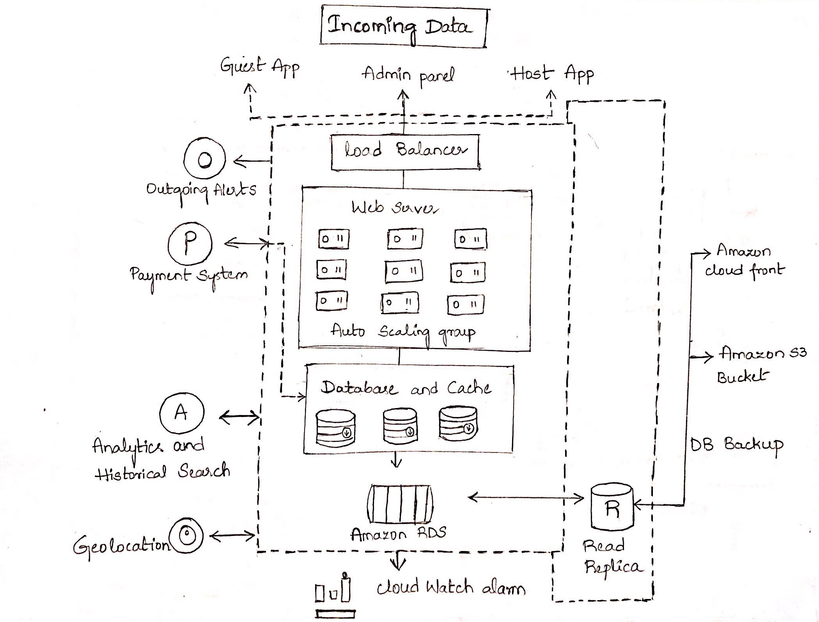
High Level Architecture
Modular flow explained in sequence.
Defined availability zones at 4 regions for disaster recovery and to prevent application downtime during intermediate deployments and maintenance activities.
Completely handled database backup – cache
Read replica for enhanced durability of the database during high-volume read traffic and heavy database workloads.

Slide 5
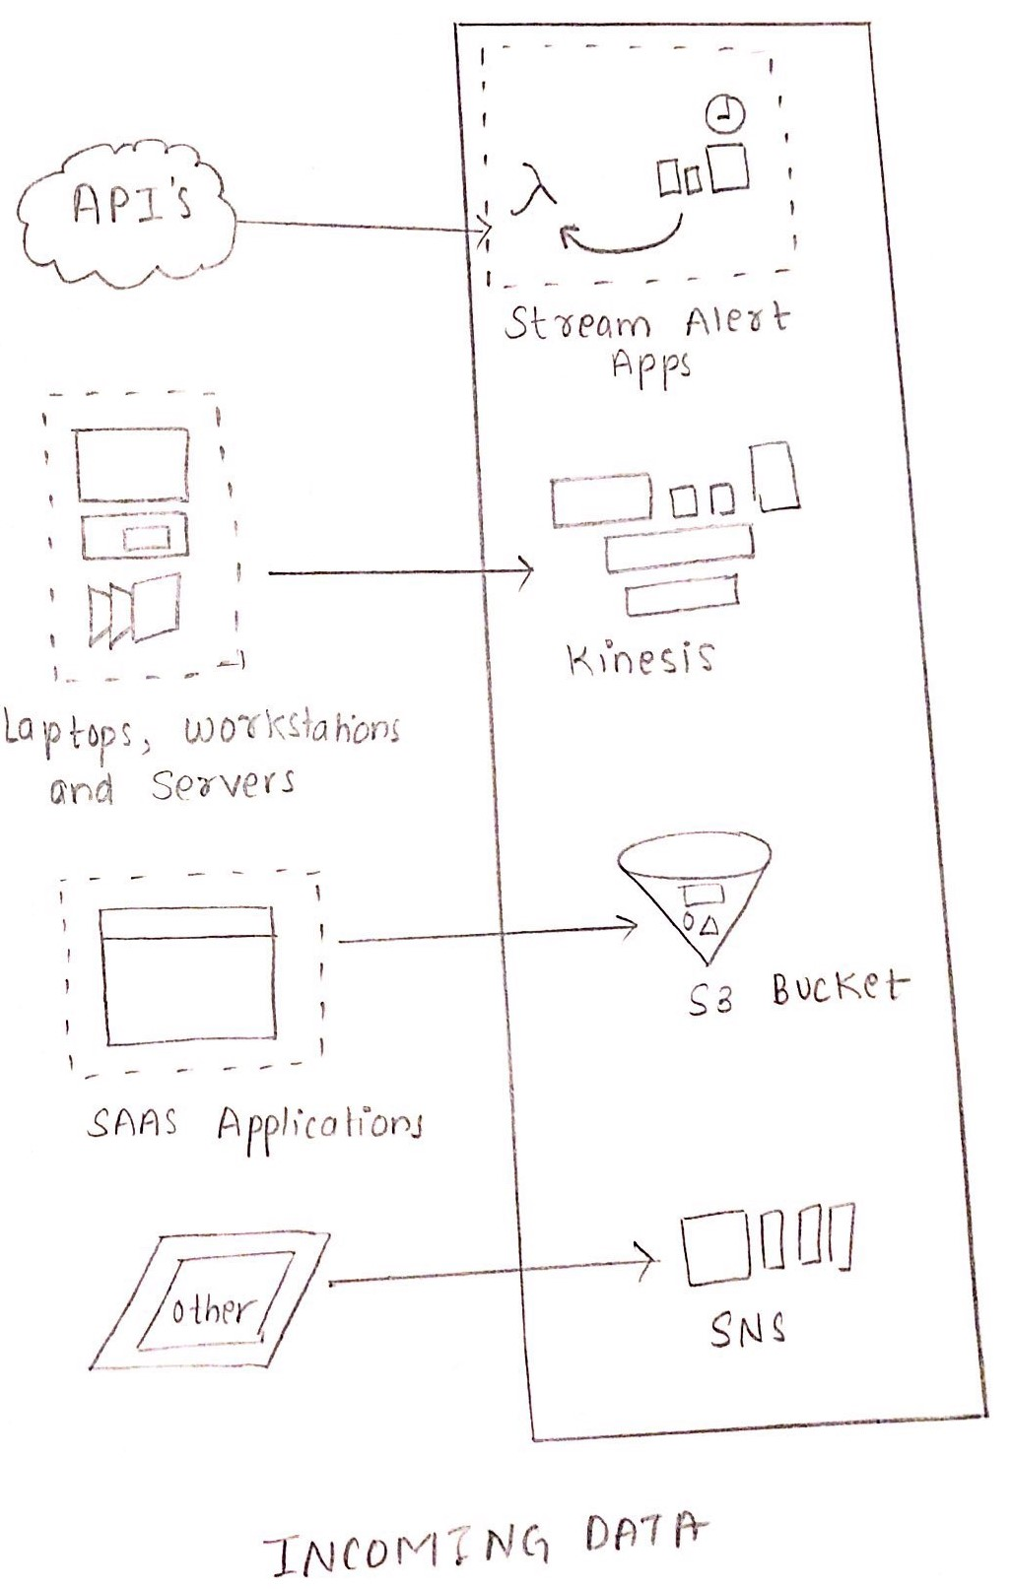
Incoming data module
Deployment on web and mobile platforms.
Incoming data from multiple sources.
API’s – Machine based interactions such as REST and SOAP. HTTP methods to access the data resources which use JSON and XML to transmit the data.
Live data from user workstations.
Data flow to kinesis and SAAS applications data to the Amazon S3 data bucket.

Slide 6
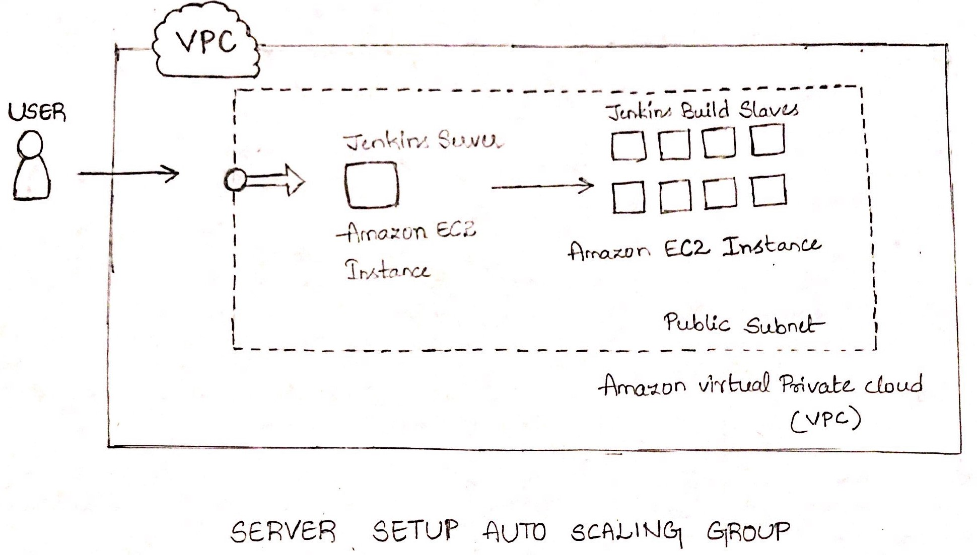
Load Balancing and auto scaling
Load Balancer
Server setup – Auto Scaling
Amazon EC2 instances.
Number of EC2 instances. VPC handles AWS resources in virtual network that would operate in data center. VPC includes public subnet which enables communication over the internet.
In this application we create public- facing subnet for the users to access the application in various platforms.
Subnets in VPC handle security groups.
Jenkins build – EC2 plug-in for handling automatic cluster overloading scenario.
Elastic load balancing to automatically route incoming web traffic caused by excess usage of EC2 instances.
It sends the data and EC2 instances to Amazon CloudWatch.

Slide 7
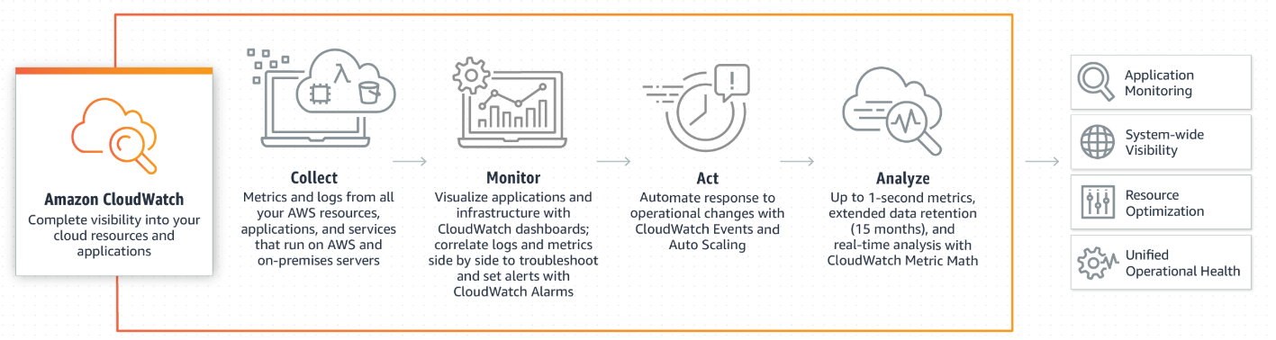
Cloud watch at a glance:

Slide 8
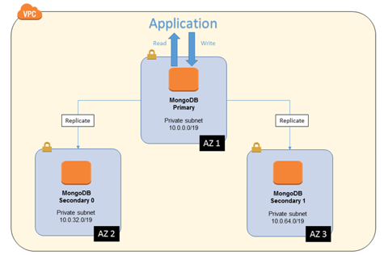
Database and Cache
Mongo DB scalable and reliable database solution.
DynamoDB not as powerful as MongoDB since no aggregation functionality.
Mongo DB atlas fully managed database service.
Easy migration services
VPC connectivity with Amazon AWS.

Slide 9
Amazon RDS
Relational data handling for cost-efficient and resizable capacity.
RDS service for Mongo DB has been adopted for the optimization of memory, I/O operations.
Database instances in Amazon VPC which helps in isolating database instances and aid in connecting existing infrastructure through industry-standard encrypted IPsec VPN.
Multi- Availability Zone deployment and replication made possible with the help of Amazon RDS.

Slide 10
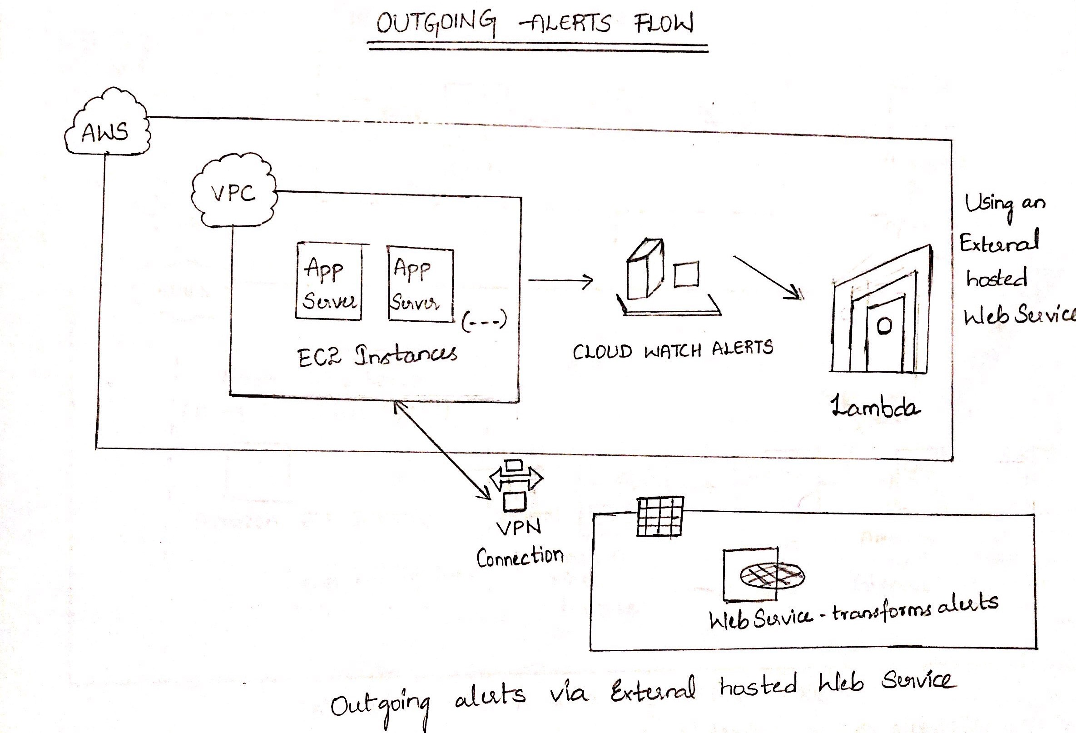
Outgoing alerts
Alerts to externally hosted web services to send notifications to the customers via SMS, Pagers or on communication channels like slack.
Handled by Lambda service.
Runs code without managing servers. Executes the code when needed and scales automatically.

Slide 11
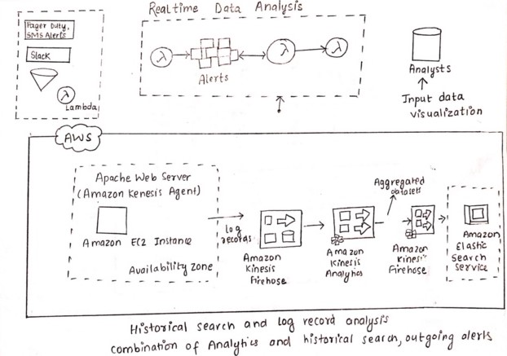
Analytics and Historical Search
Recommendations and suggestions.
Real time data handled by lambda functions. Output to the analysts in the form of visualizations.
Logs sent to Amazon Kinesis firehouse, an easy way to load streaming data into AWS.
Application code can be written in SQL to process.
Output to the custom destination i.e. Amazon S3 or Amazon Redshift.
Amazon ES ( Elastic Search Service)

Slide 12
Cluster support functionalities
Amazon EMR provides a managed Hadoop framework.
By default, Amazon EMR uses YARN to centrally manage cluster resources for multiple data-processing. EMR supports both the MapReduce and Spark.
However the requirement of in-memory caching for the data, We have proposed to use spark clusters that use directed acyclic graphs which has only one directed paths between two vertices.
Data can be directly accessed from S3 buckets and multiple interactive query requirements are handled by SparkSQL.

Slide 13
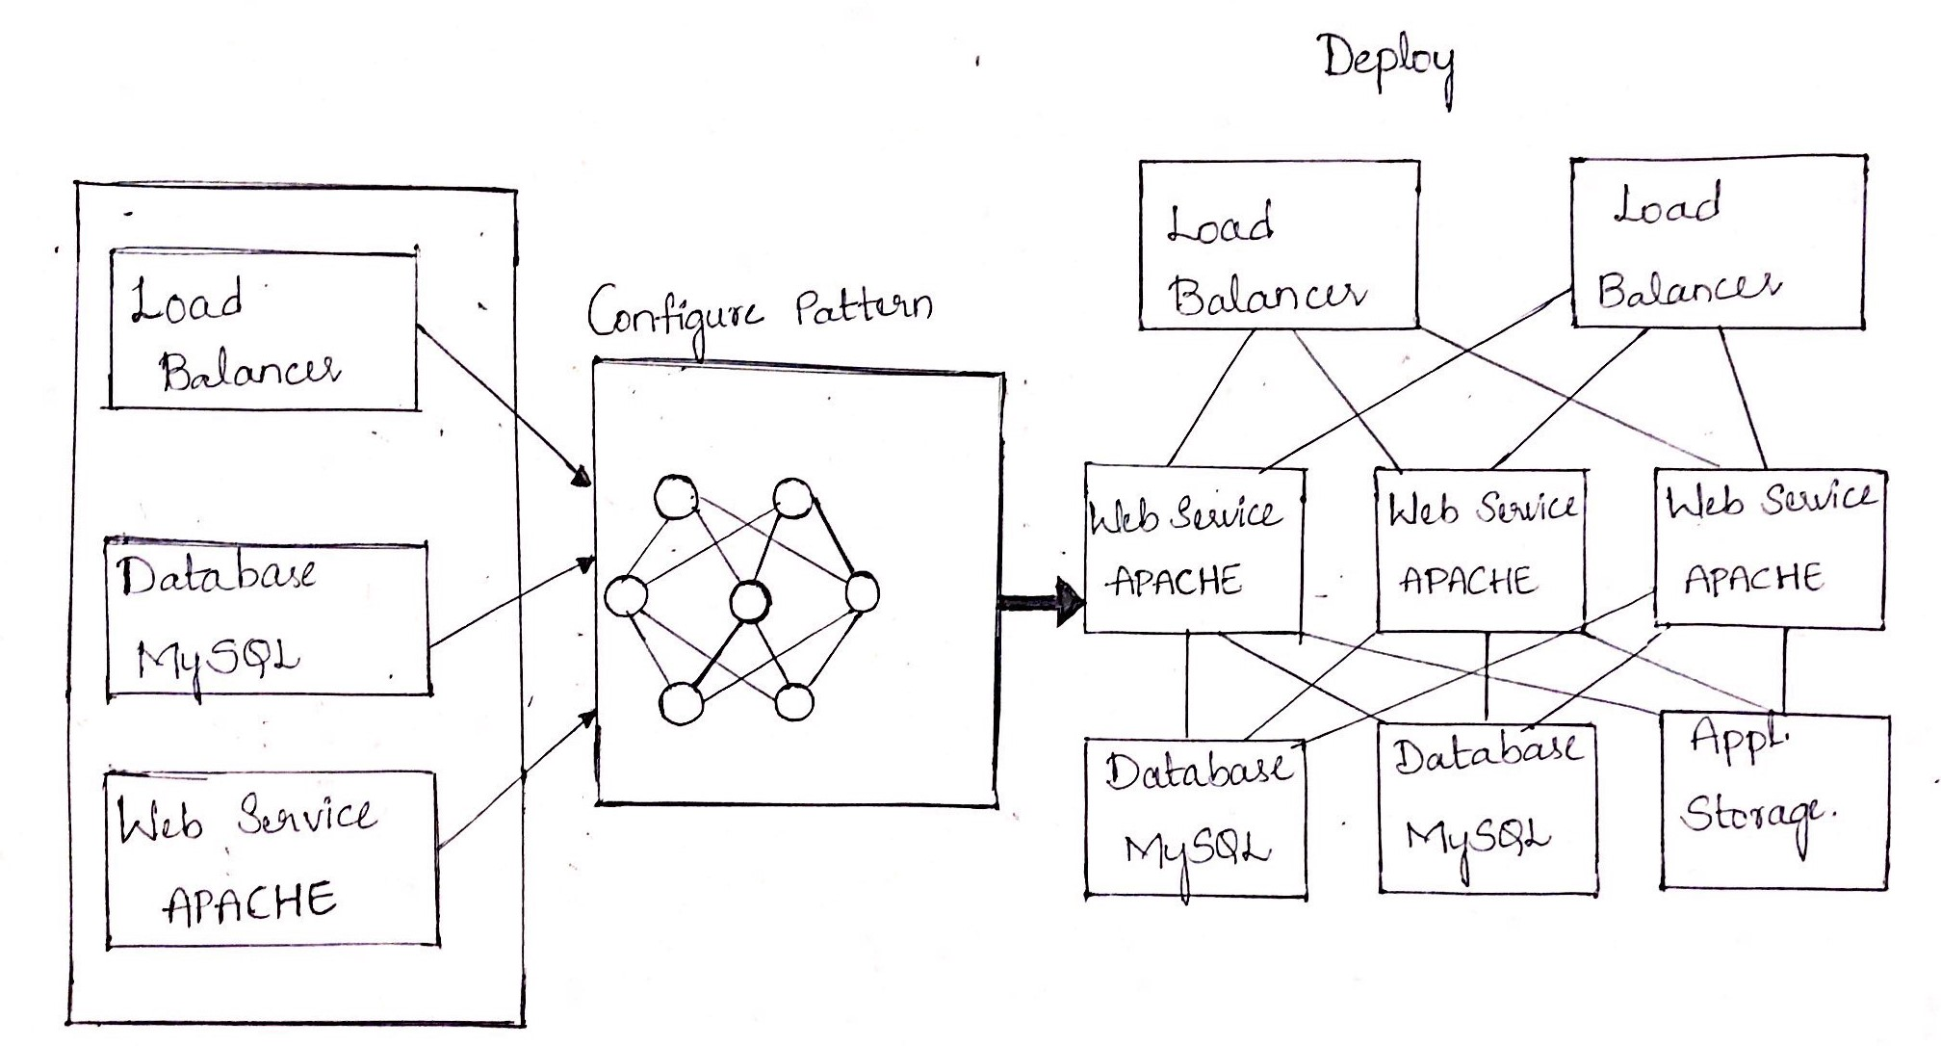
Setup and deployment:
Select the load balancer, web server and database sever appliances from a library of preconfigured virtual machine images.
Configure each component to make a custom image.
Load the static and dynamic content to the storage cloud.
Developers will then feed in the code to the new architecture making the components meet their specific requirements.
Choose a pattern to take the images of each layer i.e. web, application and security layers.
Once everything is configured virtual machines will be up and application server logs can be monitored to check if the application is up and running.
Amazon CodeDeploy helps in managing the deployments and automates the compute services.

Slide 14
Designing Private cloud For Online Reservation System
Implementation proposal using Open stack

Slide 15
The nature of Platform being Implemented
Consists of technologies such as mobile, electronic funds transfer.
Internet marketing.
Online transaction processing
Inventory management systems, and more

Slide 16
Why OpenStack?
OpenStack’s popularity for the eCommerce workload
Attributed to massive scalability
Flexibility to architect high availability
Global presence.
Fast-paced innovation.
Community Support, and low cost.
Serves the demand of Automated resource consumption mode.
Businesses like Best Buy, Walmart, overstack.com, eBay, Staples, Nike, Snapdeal and Paypal

Slide 17
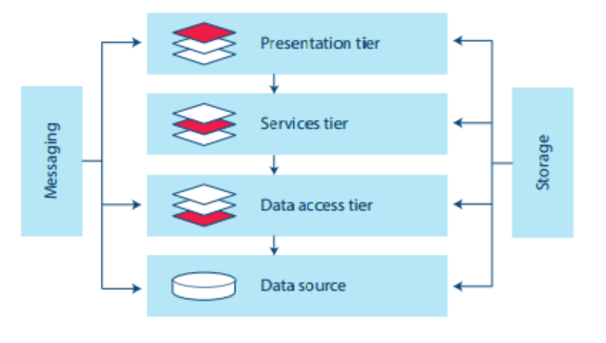
Online Reservation System High-Level Architecture

Slide 18
Introduction
Private cloud can be on-or-off-premises. Openstack helps in providing a modular framework with components that manage resources for computing, networking, storage and user interface functionalities.
The point of this model is the customer experience drives the need for dynamic content generation at a scale. This leads to a service-oriented architecture (SOA) for the applications. Each customer view is a result of collaboration between many services. To illustrate, when a customer is using the search box, the application is talking to one service, the images on the page are coming from another service, the related product recommendations are coming from yet another service, the item details from another one, and so on.
Deploy yourself for unlimited flexibility and customization.

Slide 19
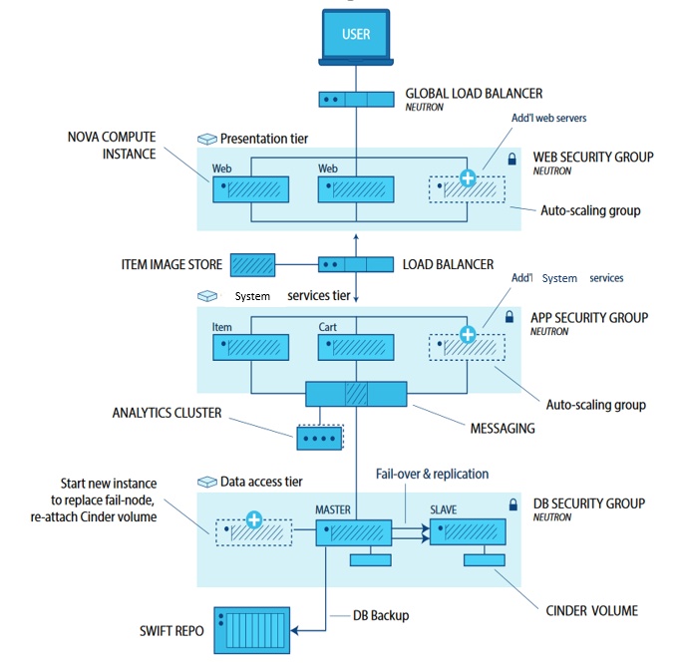
Private cloud Architecture

Slide 20
Layers in Architecture
Web presentation tier – cluster of web servers that will be used to render either static or dynamically generated content for the user.
Services tier – clusters of application servers that will be used to process the functional services of an eCommerce environment; some visible to the end user, some not.
Database tier – cluster of database servers that stores data persistently

Slide 21
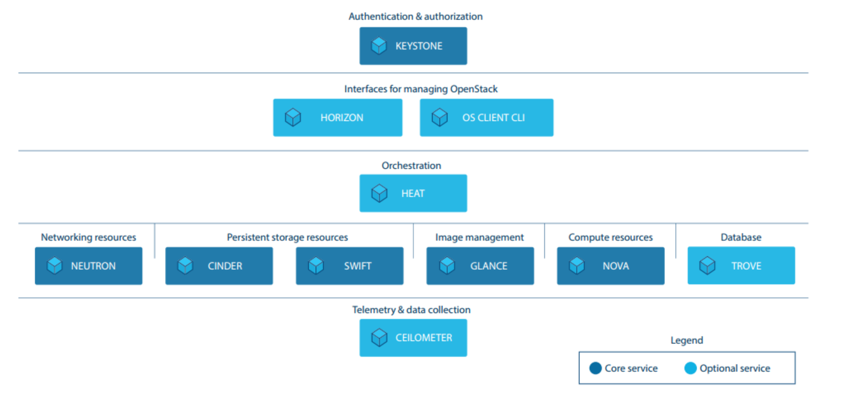
Logical Representation of Openstack Components

Slide 22
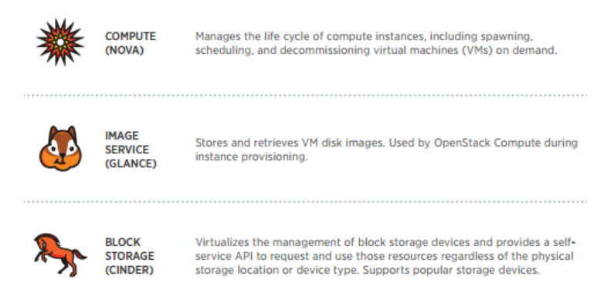
Architectural Services Components

Slide 23
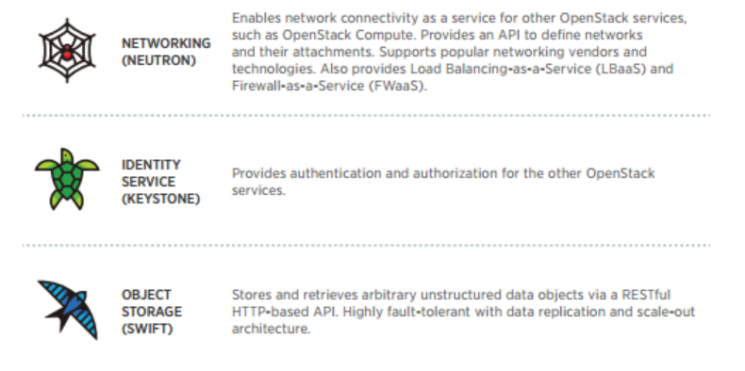
Architectural Services Components

Slide 24
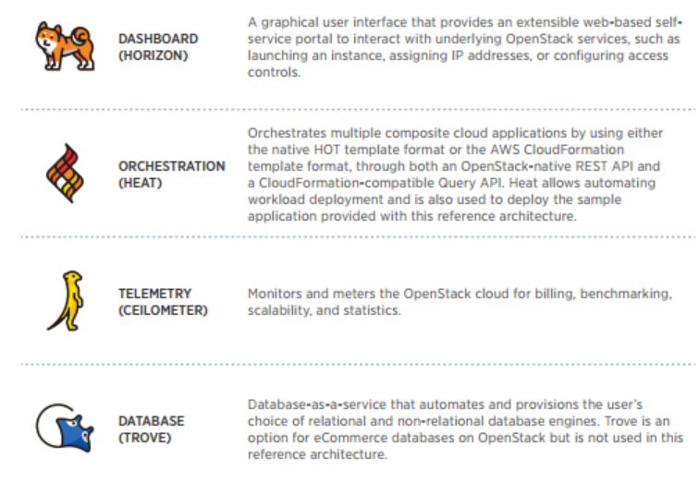
Optional Components

Slide 25
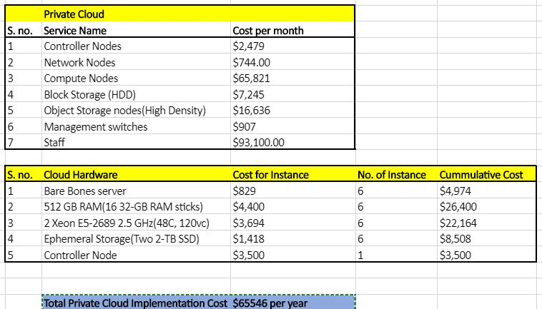
PUBLIC CLOUD COST

Slide 26
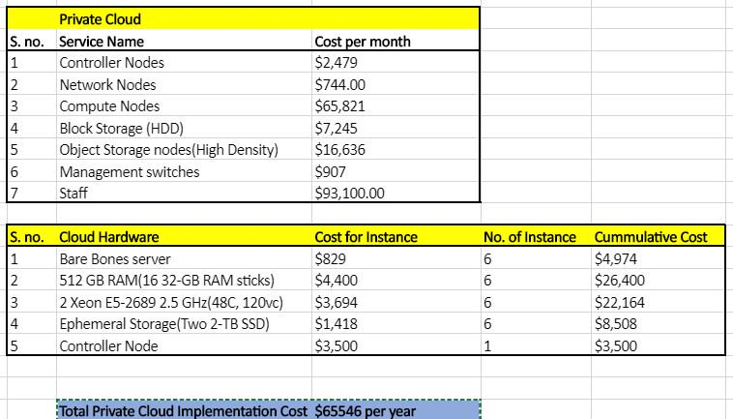
Private Cloud Cost

Slide 27
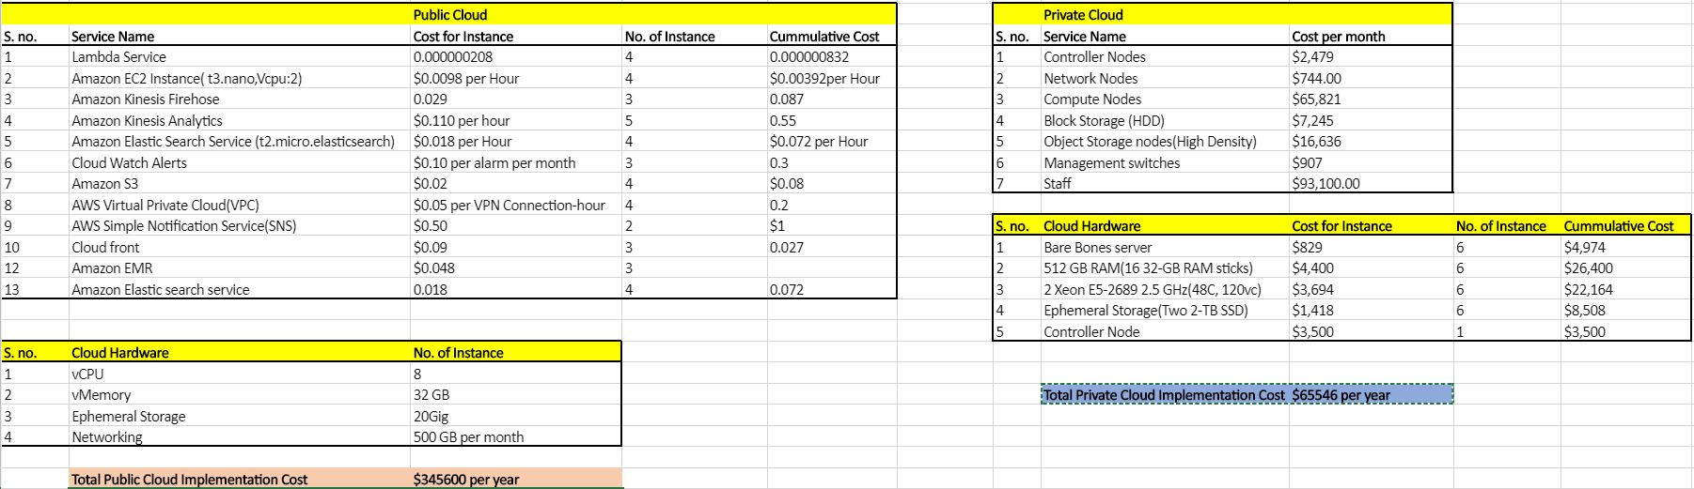
Public vs Private

Slide 28
Cost comparison of Public and Private Cloud
Total Public Cloud Implementation Cost | Total Private Cloud Implementation Cost
$345600 per year | $65546 per year

Slide 29
OpenStack VS Amazon
Services | OpenStack | AWS
Compute | Glance | AMI (Amazon Machine Image
Networking | Neutron
Monitoring | Ceilometer | Cloud watch
Identity | Keystone | IAM (Identify and Access Management)
Object storage | Swift | S3- Simple Storage Service
Block Storage | Cinder | EBS- Elastic Block Storage
Orchestration | Heat | Cloud Formation
GUI Dashboard | Horizon | Console

Slide 30
Public VS Private Recommendation
Users have an option to use a managed service offering as well buy hardware to run with an OpenStack cloud provides much more flexibility in terms of provisioning of services.
infrastructure as per the usage and pay for only the services that are essential and required.
Good in performance, scalability and also has support for all the major cloud infrastructural components, restful APIs.

Slide 31
References
Docs.aws.amazon.com. (2018). Amazon Kinesis Data Analytics: How It Works - Amazon Kinesis Data Analytics. [online] Available at: https://docs.aws.amazon.com/kinesisanalytics/latest/dev/how-it-works.html [Accessed 11 Dec. 2018].
Docs.aws.amazon.com. (2018). Amazon Kinesis Data Analytics: How It Works - Amazon Kinesis Data Analytics. [online] Available at: https://docs.aws.amazon.com/kinesisanalytics/latest/dev/how-it-works.html [Accessed 11 Dec. 2018].
Docs.openstack.org. (2018). OpenStack Docs: Compute service overview. [online] Available at: https://docs.openstack.org/ocata/admin-guide/common/get-started-compute.html [Accessed 11 Dec. 2018].
Red Hat Stack. (2018). Public vs Private, Amazon compared to OpenStack. [online] Available at: https://redhatstackblog.redhat.com/2015/05/13/public-vs-private-amazon-compared-to-openstack/ [Accessed 11 Dec. 2018].
Docs.mongodb.com. (2018). MongoDB Connector for Spark — MongoDB Spark Connector v2.3. [online] Available at: https://docs.mongodb.com/spark-connector/current/ [Accessed 11 Dec. 2018].

